Slide 1
Sales by Season Report
20XX

Slide 2
Project Overview
Gole this project highlighting the most purchased items in each season. The analysis will focus on breaking down sales patterns, identifying trends specific to each season, and visualizing the data to provide actionable insights. This dashboard will offer a clear overview of seasonal sales performance and the key products driving purchases during each period.

Slide 3
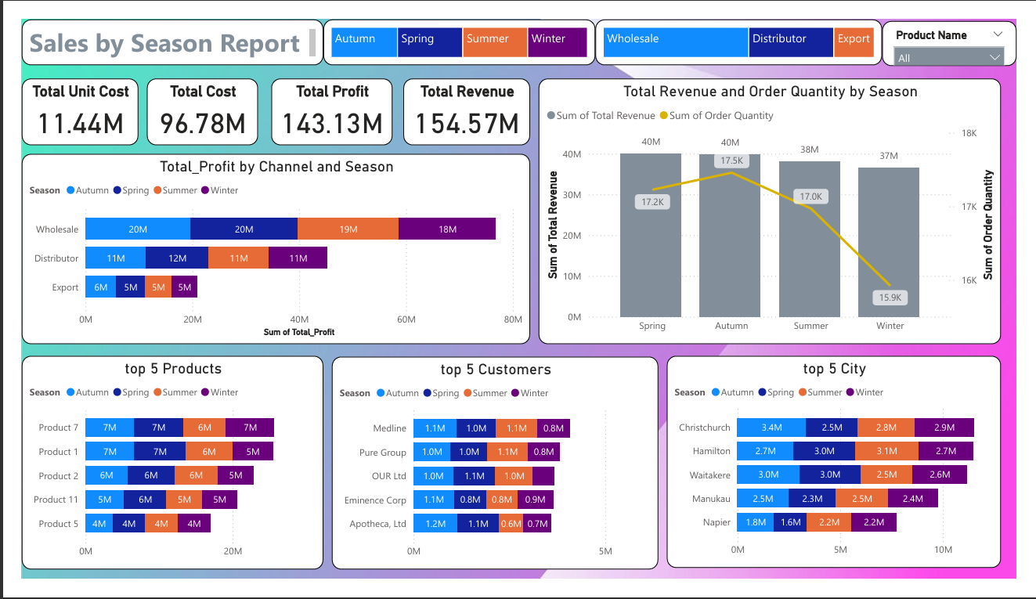

Slide 4
Dashboard Overview
Filters/Buttons: You have four season filters (Autumn, Spring, Summer, Winter) and three product channels (Wholesale, Distributor, Export), which can be used to filter the data displayed in the dashboard.

Slide 5
Key Metrics:
Total Unit Cost (11.44M): Represents the total cost incurred for units across all seasons and channels.
Total Cost (96.78M): Represents the overall expenses across all seasons and channels.
Total Profit (143.13M): Shows the total profit earned across all seasons and channels.
Total Revenue (154.57M): Represents the total revenue generated across all seasons and channels.

Slide 6
Visualization: Total Profit by Channel and Season:
Bar Chart:
Each bar represents the total profit categorized by channel (Wholesale, Distributor, Export) and color-coded by season (Autumn, Spring, Summer, Winter).
Example: Wholesale has approximately 20M profit in Autumn, Spring, and Summer, with a slight decrease to 18M in Winter.
This visualization helps compare the performance of each channel across seasons.

Slide 7
Visualization: Total Revenue and Order Quantity by Season:
Combined Bar and Line Chart: Bars: Represent the total revenue generated in each season.
Line: Tracks the order quantity corresponding to each season.
Example: The revenue remains fairly constant between 37M and 40M across all seasons, while the order quantity declines in winter (15.9K) compared to spring (17.2K).
This chart is useful for comparing revenue to the order quantity, revealing any patterns or trends, such as higher orders in specific seasons.

Slide 8
Top 5 Products by Season:
Bar Chart:
Shows the top 5 products based on the season's total sales or revenue.
Each product is listed, and its seasonal performance is represented by bars.
Example: Product 7 has 7M sales across all four seasons, indicating consistent demand.
This visualization highlights the best-performing products in each season.

Slide 9
Top 5 Customers by Season:
Bar Chart:
Shows the top 5 customers across different seasons and their contributions to sales or revenue.
Example: Medline has a higher contribution in Autumn, Spring, and Summer, with a decrease in Winter.
This chart is useful for identifying key customers and their behavior across seasons.

Slide 10
Top 5 City by Season:
Bar Chart:
Shows the top 5 city where sales were highest, broken down by season.
Example: Christchurch has the highest sales in Autumn (3.4M) and a slightly lower sales figure in Winter (2.9M).
This chart helps visualize the geographic distribution of sales and how it varies by season.

Slide 11
Insights:
Seasonality Impact: The dashboard helps identify the best-performing seasons in terms of revenue and order quantity. For instance, Spring and Autumn show stronger performance, whereas Winter shows a decline.
Channel Contribution: The Wholesale channel appears to be the dominant contributor to profit across all seasons, followed by Distributor and Export.
Product and Customer Focus: Top products and customers are consistent across all seasons, but their purchase volumes vary slightly, highlighting potential seasonal demand patterns.
City Trends: Christchurch leads in sales across all seasons, but other cities like Hamilton and Waitakere also contribute significantly.

Slide 12
THANK YOU!
20XX

